Slide 1
Introduction to R
Richard Johansen
September 12th 2018

Slide 2
Workshop Agenda
Workshop Expectations
Why R?
Understanding Data
Visualizations
The Scenario
Plotting in ggplot2

Slide 3
Workshop Agenda
Workshop Expectations
Why R?
Understanding Data
Visualizations
The Scenario
Plotting in ggplot2

Slide 4
Expectations
Prerequisites:
R and R studio installed
Goal:
Explore R and R studio environment
Basic functions of R
Import data
Download packages
Simple modeling
Visualize data
Export data and visualization
Caveat
This is only an introduction to the R and R studio environment. Learning a new programming language, like a spoken language, takes years of practice. So we cannot cover everything but we will highlight many common features that most of you will use most of the time.

Slide 5
Workshop Agenda
Workshop Expectations
Why R?
Understanding Data
Visualizations
The Scenario
Plotting in ggplot2

Slide 6
Workshop Agenda
Workshop Expectations
Why R?
Understanding Data
Visualizations
The Scenario
Plotting in ggplot2

Slide 7
What is Data?
Data is a collection of objects defined by attributes
An attribute is a property or characteristic of an object
Examples: eye color of a person, temperature, etc.
Synonyms: Columns, variables, fields, characteristics, features, etc.
An object is the phenomena being described or evaluated
Examples: Bob/Sarah, house, substance, etc.
Synonyms: Rows, records, points, cases, samples, instances, etc.

Slide 8
Attribute Classification
Discrete Attribute – has a infinite or countably infinite set of values
Examples: zip codes, number of words,
Typically represented as integers
Continuous Attribute - has real numbers as attribute values
Example: temperature, height, weight
Typically represented as floating point (decimal)

Slide 9
Important Attribute Classes
Categorical
Nominal - Data that can be counted, but not aggregated or ordered
Examples: Eye Color, Zip Code, Music Genre
Ordinal - Data that can be counted and ordered, but not aggregated.
Examples: Grades, Clothing Size, Positions (in a race)
Numerical
Interval (metrics) - The difference in values are constant and meaningful
Examples: The difference between a temperature of 100°F and 90°F is the same difference as between 90°F and 80°F.
Ratio - An interval scale with an absolute zero
Examples: Income, Height, Weight

Slide 10
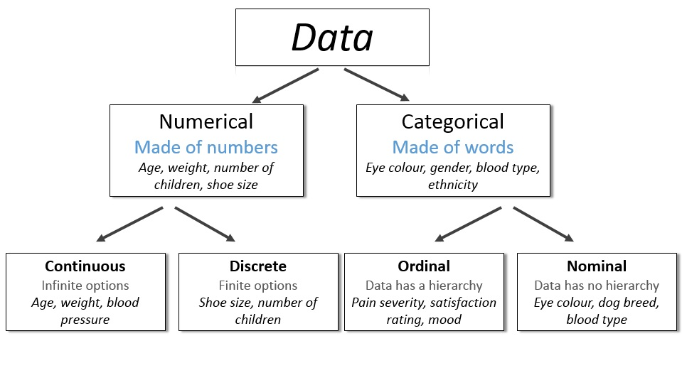
http://survivestatistics.com/variables/

Slide 11
Primitive Data Types
Boolean:
True (T) or False (F)
Char:
Characters and Strings – “A”, “Beta”, “There are different data types!”
Int:
Integers – (1, 2, 100)
Float/Double:
Decimal – (0.1, 0.2, 0.1352)

Slide 12
Workshop Agenda
Workshop Expectations
Understanding Data
Visualizations
The Scenario
Plotting in ggplot2

Slide 13
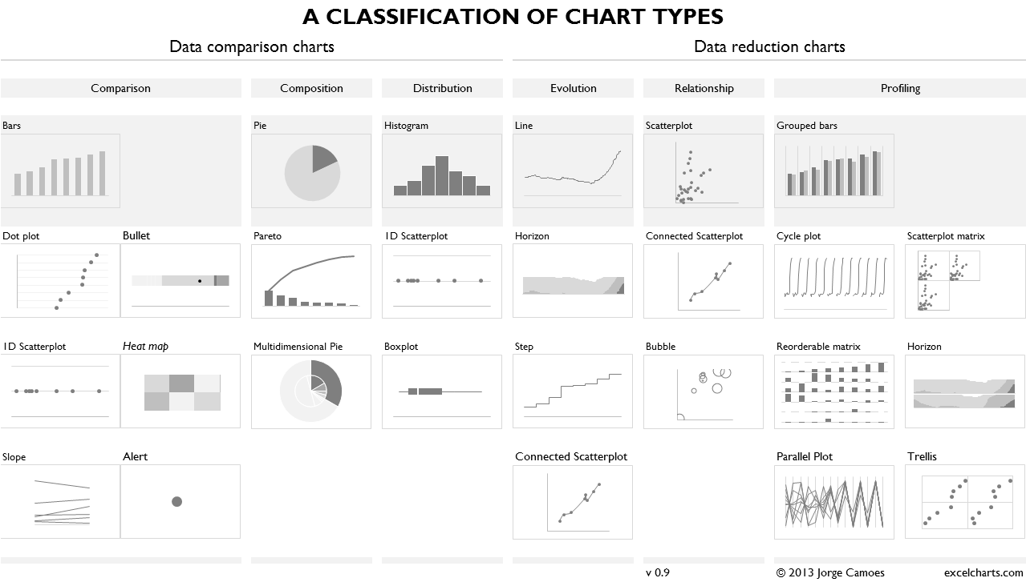
Four Basic Chart Types
Comparison
Composition
Distribution
Relationship
https://excelcharts.com/classification-chart-types/

Slide 14
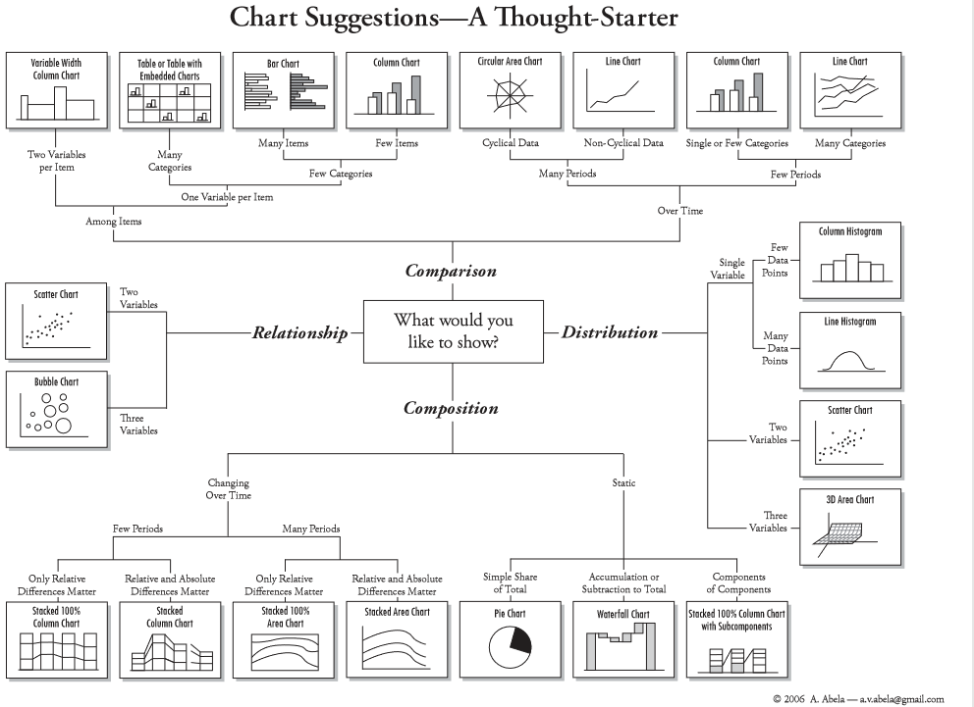

Slide 15
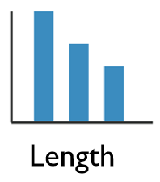
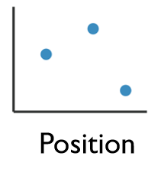
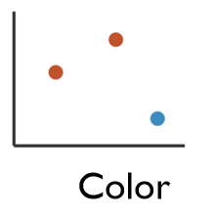
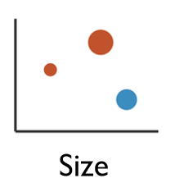
Enhancing Visualizations
1 Dimensional Data
Length
2 Dimensional Data
Position
2+ Dimensional Data
Position
Color Hue/Saturation
Size
Shape

Slide 16
Workshop Agenda
Workshop Expectations
Understanding Data
The Scenario
Visualizations

Slide 17
Titanic Data Set
We will use the Kaggle Competition’s Titanic Machine Learning from Disaster Dataset
Everyone is familiar with the Titanic
The data set is a good representation of real world data
Following the teaching model from Dave Langer’s presentation on Data Science Dojo

Slide 18
Titanic Data Dictionary
Variables:
Survival – Survival (yes=1, no=0)
Pclass – Ticket Class (1st class, 2nd class)
Sex – Gender (Male or Female)
Age – Passenger age
Sibsp – # of Siblings/Spouse
Parch – # of Parents/Children
Ticket – Ticket Number
Fare – Passenger Fare
Cabin – Cabin Number
Embarked – Port of Embarkation

Slide 19
Your Job
You are hired as a consultant and have been tasked with analyzing the titanic data set.
Your goal is to explore patterns and trends to explain what influenced the survival rate of the passengers on the Titanic.

Slide 20
Grammar of Graphics
Originated by Leland Wilkinson, simplified by Hadley Wickham and others.
Data – The raw materials of your visualization
Layers – What you actually see on the plot (plots,lines,etc.)
Scales – Maps the data to grpahical output
Coordinates – The visualization’s perspective (normally a grid)
Faceting – Provides details into the data (analoguous to pivot tables)
Themes – Control the details of the display (color scheme, fonts)
http://vita.had.co.nz/papers/layered-grammar.pdf
Notes:
Alison

Slide 21
The Basics
Data – The raw materials of your visualization
Aesthetics – The mapping of your data to the visualization
X-axis is age
Y-axis is survival
Layers – Any visualization requires at least one layer and in ggplot2 these are typically the geoms.
Example a barchart is geom_bar()

Slide 22
Questions?

